Slide 1
Leveraging Student Feedback to Improve the Learning Environment: A Discussion with Solving with Students Cadre Participants
Katrice Dixon, Broward County
Alexia Hamilton, Broward County
Jordan Kobelin, Clay County
Hillary Van Dyke, Impact Florida

Slide 2
Impact Florida Summit 2023

Slide 3
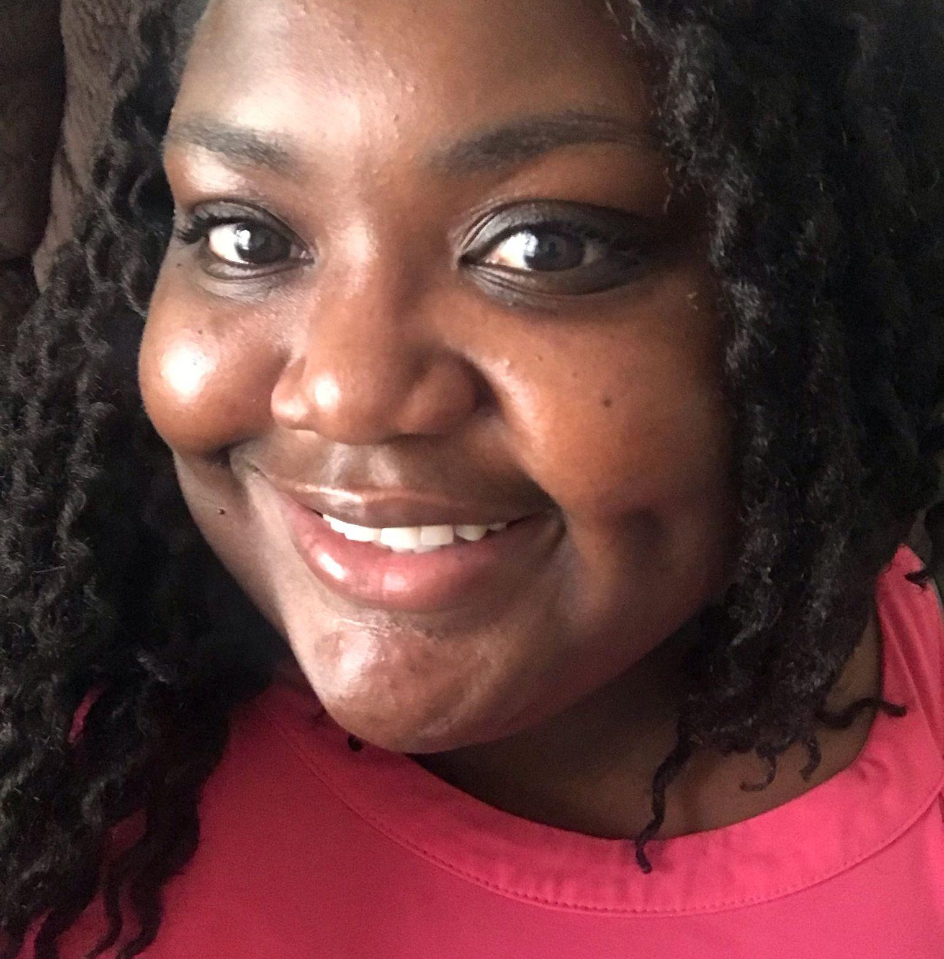
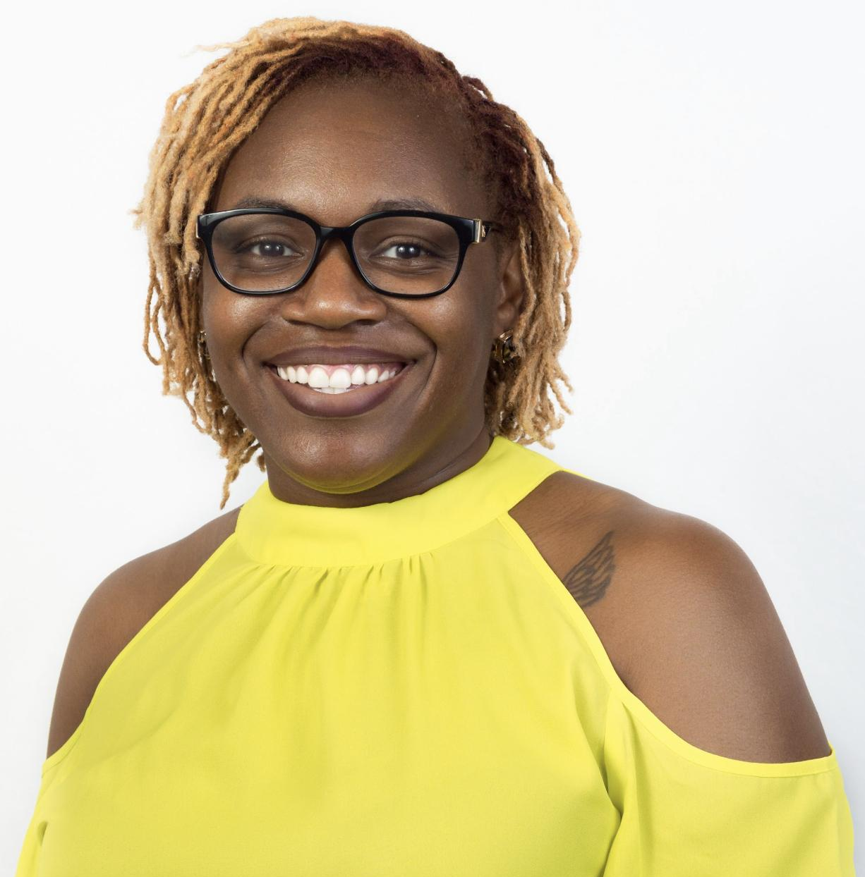
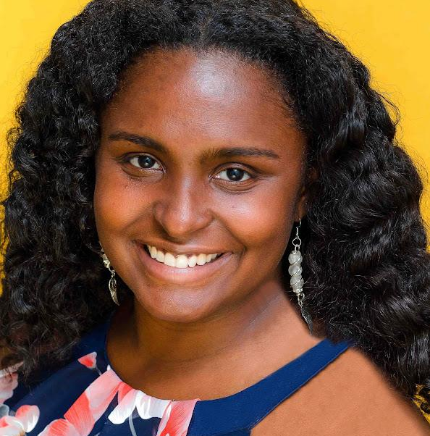
Solving with Students Panel
Renee Labunski
Hillsborough County
Alexia Hamilton
Broward County
Katrice Dixon
Broward County
Hillary Van Dyke
Impact Florida

Slide 4
5 Conditions that Support Great Teaching
SHARED VISION: A shared vision of what great teaching looks like — so that every student can succeed
INSTRUCTIONAL MATERIALS: High-quality, academically rigorous instructional materials
PROFESSIONAL LEARNING: Effective professional learning systems and structures
EMPOWERED LEADERS: School leaders who focus on scaling great teaching beyond individual classrooms
EFFECTIVE USE OF DATA: Regular use of data and a focus on continuous improvement

Slide 5
5 Conditions that Support Great Teaching
SHARED VISION: A shared vision of what great teaching looks like — so that every student can succeed
INSTRUCTIONAL MATERIALS: High-quality, academically rigorous instructional materials
PROFESSIONAL LEARNING: Effective professional learning systems and structures
EMPOWERED LEADERS: School leaders who focus on scaling great teaching beyond individual classrooms
EFFECTIVE USE OF DATA: Regular use of data and a focus on continuous improvement

Slide 6
Districts Represented in the Cadre
130+ Teachers from
28 districts applied
80 Teachers from
19 districts were accepted
34 Alumni and 64 New Members
Teachers in the Cadre
High School: 42.5%
Middle School: 56.25%
1-3 Years: 12.5%
4-10 Years: 35%
11-15 Years: 15%
16-20 Years: 17.5%
21+ Years: 18.75%
District | Selected
Bay | 1
Brevard | 2
Broward | 4
Clay | 5
Collier | 5
Flagler | 10
Glades | 2
Hillsborough | 12
Levy | 3
Manatee | 4
District | Selected
Miami-Dade | 5
Nassau | 2
Okeechobee | 3
Orange | 6
Osceola | 2
Pasco | 6
Pinellas | 2
Putnam | 4
Santa Rosa | 1
TOTAL | 80

Slide 7
Goals of the Cadre
LEARN ABOUT STUDENTS.
Complete five cycles of PERTS Elevate with classes with at least 80% student participation on surveys.
GROW TEACHERS’ PRACTICE.
Select at least one learning condition to focus on throughout the cadre and commit time to analyze survey results and celebrate growth.
COMMIT TO SHARING WITH STUDENTS.
Share the journey with students. Explain why teacher is using Elevate, how much their honesty and experience counts, and how teacher is making adjustments based on their feedback.

Slide 8
How We Work With Our Technical Assistance Partners:
Impact Florida created the Solving with Students Cadre to support secondary math teachers from across the state to use student experience feedback and data in their classrooms.
The PERTS Elevate Survey is online and FREE to all educators in 6-12 classrooms nationwide. Cadre members will give the survey 6 times throughout the 22-23 school year.
NTC supports 50 teachers with 1:1 coaching throughout the survey cycles and also completes an overall cadre evaluation.
Notes:
technical assistance partners

Slide 9
Elevate Student Surveys Elevate students’ voices to enhance engagement, excellence, and equity.

Slide 10
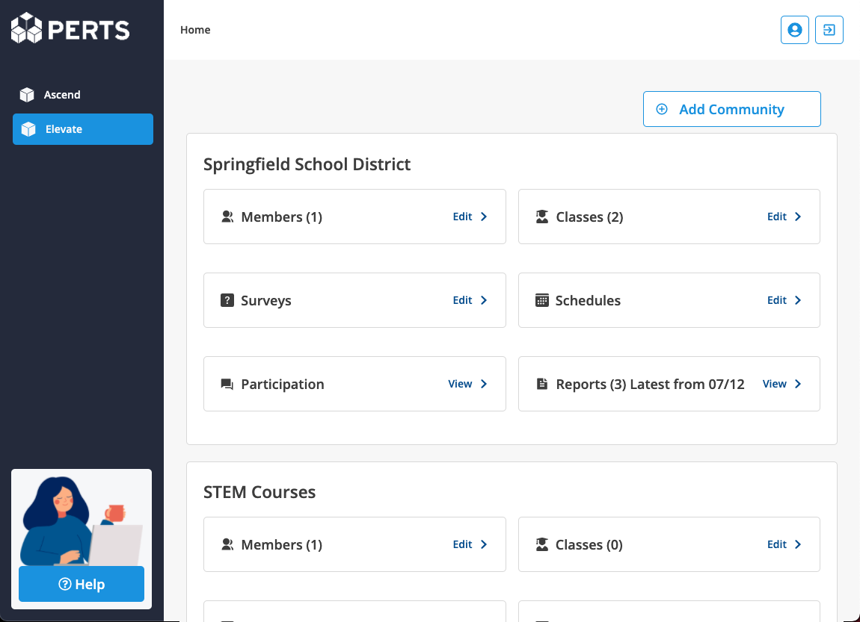
What is Elevate?
A professional learning program that elevates students voice to help educators create engaging and equitable experiences that support learning.

Slide 11
Fast & Easy
Surveys take 5-10 minutes. Take a sample survey at perts.me/H6AK
Students can take surveys anywhere on any computer, tablet, or phone with internet. No downloads needed. Teachers can see who responded to arrange make-ups.
Surveys have built-in audio for students with reading difficulties and accessible in Spanish.
Professional learning content is delivered online. Teachers learn asynchronously at their own pace.

Slide 12
Elevate Measures (Survey Questions)
Affirming Identities This teacher makes sure different backgrounds and perspectives are valued and supported. I see positive examples of people like me in the things we learn in this class. | Classroom Community In this class, we have lots of opportunities to interact with each other. This class is a welcoming place for everyone. I feel comfortable sharing my thoughts and opinions in this class. | Feedback for Growth This teacher lets me know they believe I can do well in this class. I get specific suggestions about how to improve my work. In this class, it is more important to try than to get things right the first time.
Meaningful Work In this class, we do meaningful work, not busy work. What we learn in this class is connected to real-life. This teacher makes what we're learning really interesting. | Student Voice I have the opportunity to make choices about my work in this class. In this class, my ideas are taken seriously. This teacher responds to student suggestions to make our class better. | Teacher Caring I feel like this teacher is glad that I am in their class. This teacher cares about my life outside of school. This teacher treats me with respect.
*Survey Questions remain the same on every survey. Students will see multiple choice and free response.
Notes:
Consider your own classes or groups you lead. How do you think would rate you on these from Strongly agree to strongly disagree. Why or why not? Discuss w/ partners

Slide 13
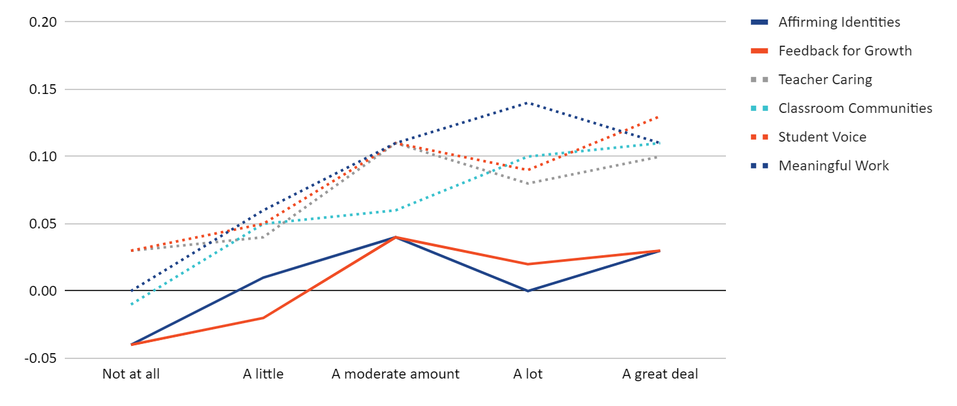
Results from the Spring 2022 Cadre
Teachers who engaged students in more conversations about their focus area and/or strategy showed more improvements.
+20 pts
+15 pts
+10 pts
+5 pts
No change
-5 pts
Not at all
A little
A moderate amount
A lot
A great deal
Notes:
Another interesting point I wanted to share is that, in general, teachers who engaged students in more conversations about their focus area and/or strategy showed more improvements in learning conditions. The Y axis here represents the amount of improvement from Survey 1 to Survey 4, and the X axis represents the extent to which teachers said they talked with their students about the data or their strategy.
You can see that on average, the declines occurred among teachers who had little or no engagement of students in those conversations. And in general, teachers who showed big gains in the +5 or more point range were engaging their students in those conversations at least a moderate amount.

Slide 14
Teacher Panel
Jordan Kobelin
Clay County
Alexia Hamilton
Broward County
Katrice Dixon
Broward County

Slide 15
Closing
Turn and talk with your neighbors and discuss
1- What thoughts do you have about using the Perts Elevate tool to improve instruction?
2- What are your next steps to implement this or something similar back at your site?

Slide 16
Please join us for lunch in the Grand Foyer.

